Slide 1
The Battle of Neighborhoods
State of Sao Paulo, Brazil

Slide 2
Introduction – business problem
The state of Sao Paulo is considered the most populous of the Country and it is natural to have a high concentration of business in the same region. However, we can notice that often the concentration of companies is in the same activity like markets, hotels and drugstores, which creates opportunities for new businesses not yet explored. So, the challenge is identify these unexplored areas and suggest which type of business the area needs and show the concentration for each one.
This is the goal of this project: identify new opportunities and suggest to anyone interested.

Slide 3
Introduction – business problem
To do it, we will use the service provided for Foursquare to find all the companies and its segment to cross the location with the map of state of Sao Paulo. Several techniques will be used along this project to show the analysis, like Folium, K-Means and others.

Slide 4
DATA REQUIREMENTS
The dataet used was obtained from Anatel in this link: https://www.anatel.gov.br/Portal/verificaDocumentos/documento.asp?numeroPublicacao=285354&assuntoPublicacao=Rela
Note that the file is a PDF and contains several information about the State, like Longitude and Latitude (in degrees). It is important to mention that this dataset was previosly treated on Excel – the coordinates were converted to decimal. Nothing else was needed for the analysis.

Slide 5
METHODOLOGY
Once we have the neighborhoods data of Sao Paulo and also have the most popular venues in each neighborhood obtained using Foursquare API we can perform one hot encoding on the obtained data set and use it find the 10 most common venue category in each neighborhood. Then clustering can be performed on the dataset. Here K - Nearest Neighbor clustering technique have been used. To find the optimal number of clusters silhouette score metric technique is used.
The clusters obtained can be analyzed to find the major type of venue categories in each cluster. This data can be used to suggest business people, suitable locations based on the category.

Slide 6
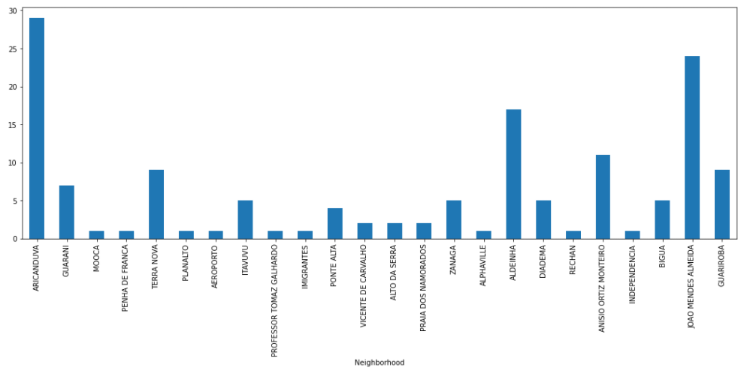
ANALYSIS
Looking into the dataset we can observe that many neighborhoods has less then 5 venues which we can remove to perform a better analysis and better results.
The chart bellow shows the concentration of each venues.

Slide 7
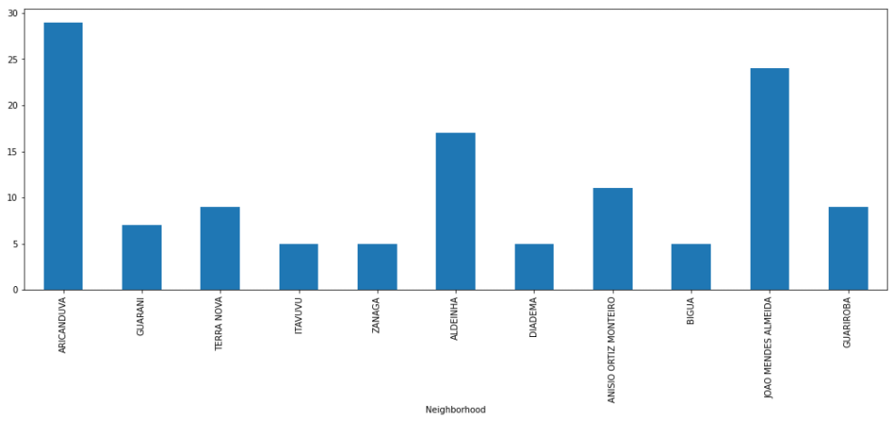
ANALYSIS
After fill out the venues <= 5 we obtained the following chart.

Slide 8
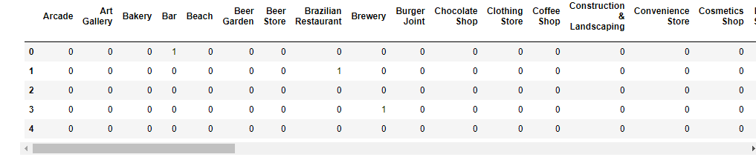
ANALYSIS
One hot encoding is performed on the filtered data to obtain the venue categories by transposed into columns.
This is used to obtain the top 10 most common venues in each neighborhood. Then the resultant dataset can be used for the clustering (K-Means).

Slide 9
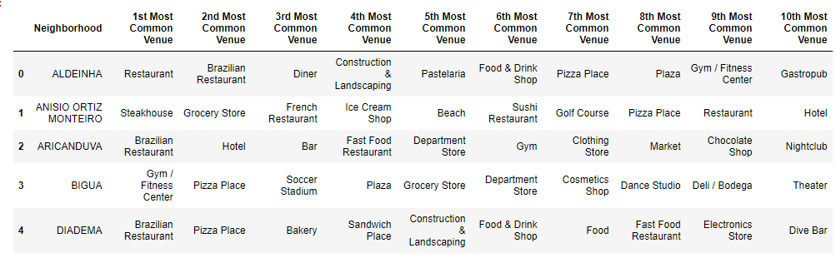
ANALYSIS
One hot encoding is performed on the filtered data to obtain the venue categories by transposed into columns.
This is used to obtain the top 10 most common venues in each neighborhood. Then the resultant dataset can be used for the clustering (K-Means).

Slide 10
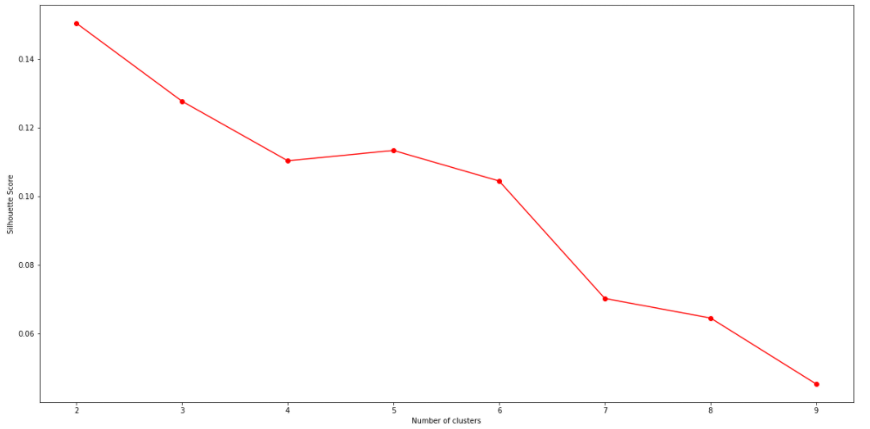
ANALYSIS
From the plot we choose to use K = 5.

Slide 11
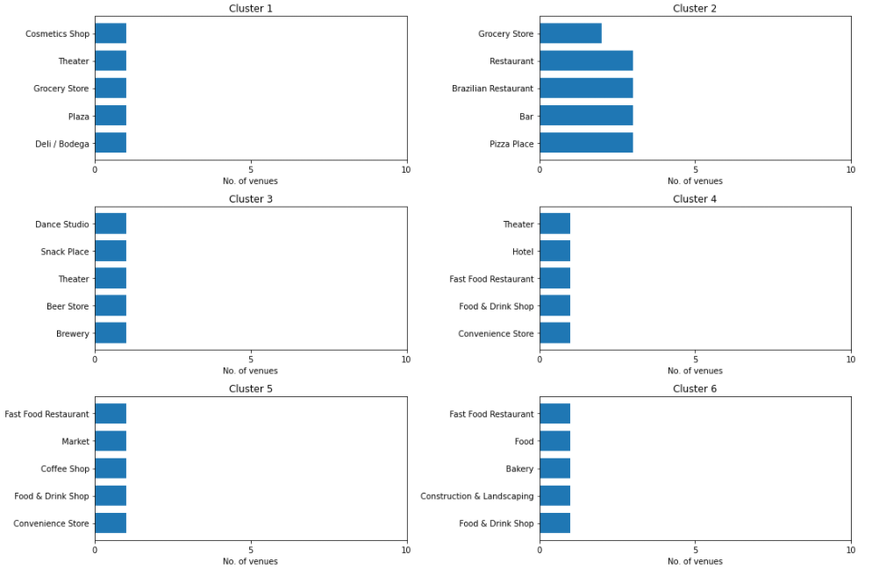
Final results
From the graphs plotted, we are able to concluded several things as the best place do start a new hotel business is on the Cluster 5.

Slide 12
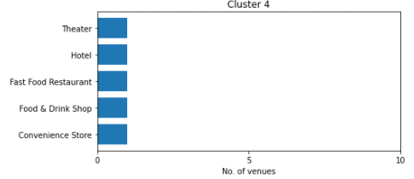
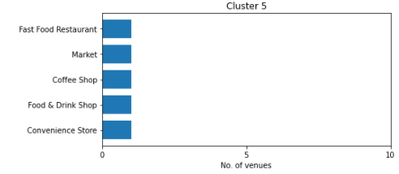
Final results
The reason is simple: As we can see the cluster 4 is where we have more Hotel, so this Cluster is not the best choice to open another one. Otherwise, the others clusters does not have Hotels. It does not mean that all these clusters are good to open one. From my understanding, every Hotel needs to be well located, in other words it means that Hotels needs Restaurants, Coffee Shops and this kind of store around. So, based on that, we can concluded that the Cluster5 its the best option once we have Market, Restaurant, Coffee Shop and others.

Slide 13
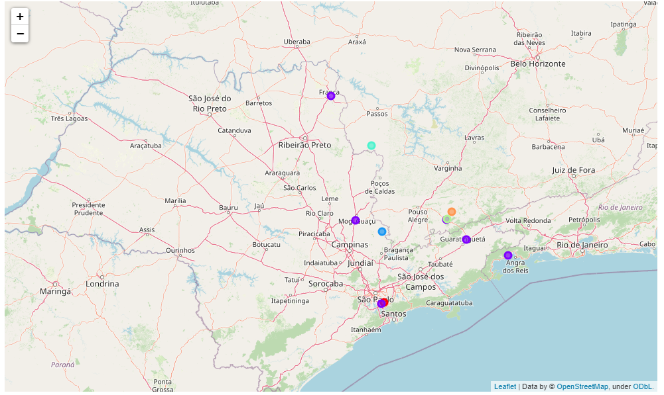
Final results
The following is a map of State of Sao Paulo with the neighborhood clusters superimposed on top of it. This map can also be used to select a vast suggestion area for a particular type of business based on the category.

Slide 14
CONCLUSION
The purpose here in this project (Capstone - The Battle of Neighborhoods) was to analyze the neighborhoods of state of Sao Paulo and create a clustering model to suggest the best location to start a new business. All the data was obtained from an online source (Anatel) and from the Foursquare API that was used to find the major venues in each neighborhood. But we found that a considerable numbers of neighborhoods had less than 5 venues returned. So, in order to build a good Data Science model, these locations were all removed. Thus, the remaining locations were used to create the clustering model. The best number of clusters (5) was obtained using the silhouette score. cluster. One example was presented (Hotel) and a map showing the clusters have been showed. It is important to mention that both these can be used by stakeholders or investors to decide the location for the new business desired.

